Slide 1
Image deblur and super resolution
Joseph j valavi

Slide 2
introduction
Blur is an unsharp image area caused by camera or subject movement, inaccurate focusing, or other causes for pixalation.
It is also considered as a random noise, which makes features of images unclear.
Low resolution images cannot accurately give efficient data ,due to the poor quality when zooming .
Deep learning can be applied to enhance the image for deblurring the image and upscaling the resolution for capturing the features of the image.

Slide 3
RELEVANCE OF THE TOPIC
Image deblurring is a process, which is used to make pictures sharp and extract useful information from it.
Image deblurring have wide applications from consumer photography, e.g., remove motion blur due to camera shake, to radar imaging and satellite imaging.
High resolution image offers a high pixel density and thereby more details about the original scene
Many applications require zooming of a specific area of interest in the image where high resolution becomes essential, e.g. surveillance, forensic ,medical imaging and satellite imaging applications.

Slide 4
Existing system
The existing system uses the image processing filters like wiener filters to remove the noise present in image.
This method of removing noise has least performance.
Only greyscale images can be denoised using this filters.
Super resolution is not achieved by this image processing method.
PROPOSED SYSTEM
The system uses deep learning methods to image deblurring , cnn autoencoder for deblurring and SRGAN for super resolution.
The system is hosted as web application which consist of the image deblur and super resolution applications.

Slide 5
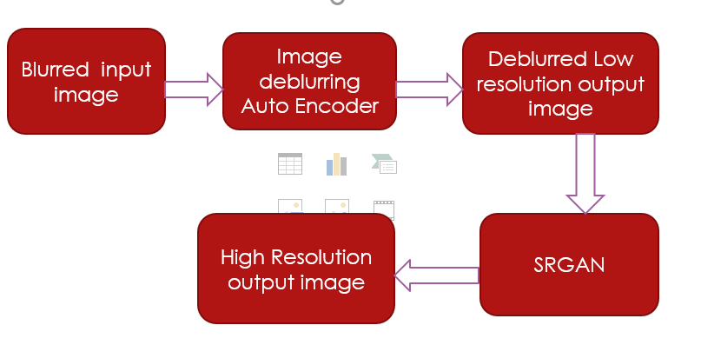
System design

Slide 6
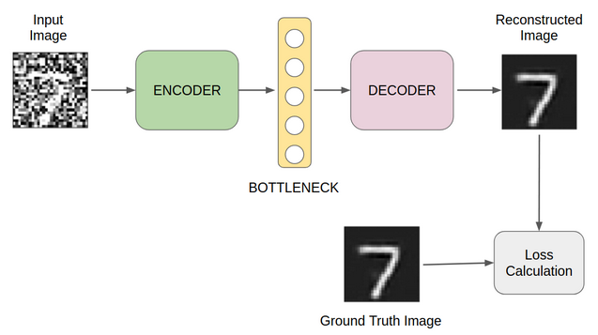
Autoencoder model
Auto encoder is uses for image deblurring, which takes blurred image as input and gives a deblurred image
The encoder takes the input, processes it, extracts features, and then stores the data in the hidden layer. A decoder does the opposite of what an encoder does.
The output of the decoder is given to a unblurred sharp image which generate a loss with input and ground truth.
The loss value is feedback to decoder for creating a deblurred image.
Autoencoder model

Slide 7
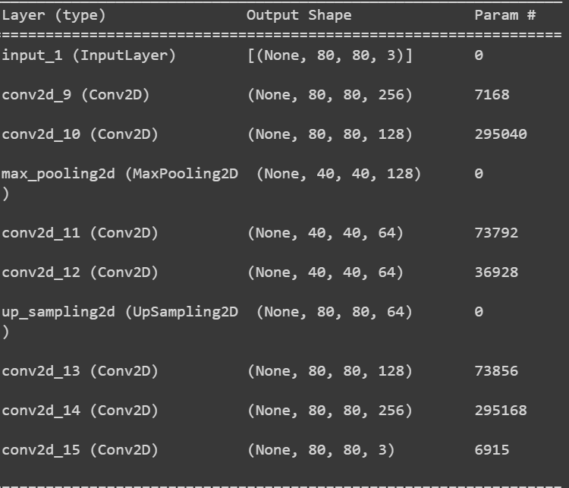
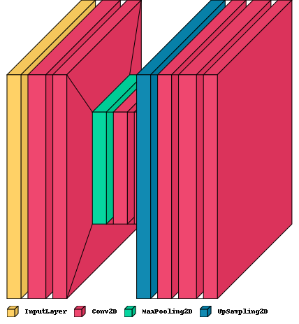
Deblur Autoencoder model

Slide 8
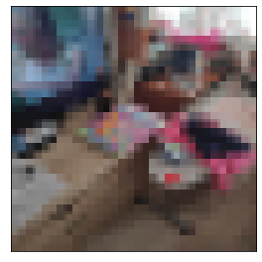

Deblurring input and outputs
input
output

Slide 9
Image super resolution
Image super resolution is to recover finer textures from the image when we upscale it so that it’s quality cannot be compromised.
The generative adversarial neural network is used for image super resolution.
SRGAN is used for image super resolution.
It consists of generator and discriminator , A high-resolution image (HR) is downsampled to a low-resolution image (LR).
The generator architecture than tries to upsample the image from low resolution to super-resolution. After then the image is passed into the discriminator,
The discriminator and tries to distinguish between a super-resolution and High-Resolution image and generate the adversarial loss which then backpropagated into the generator architecture.

Slide 10
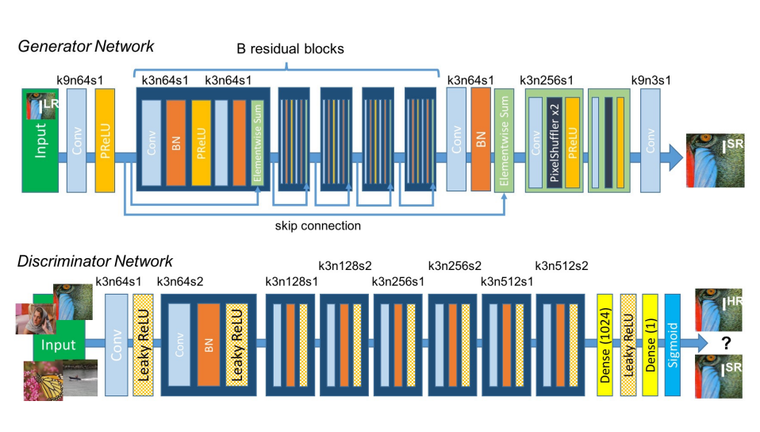
Srgan architecture

Slide 11

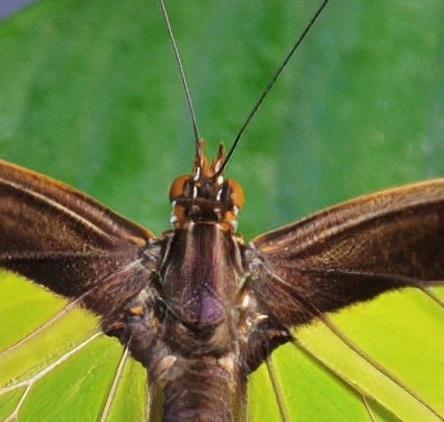
Image Super resolution
Input
output

Slide 12
modules
Image data preprocessing
CNN Model creation
Training model
SRGAN generator discriminator model
Testing and validation
User interface

Slide 13
Ide’s and frameworks used
Google colab
Visual studio code
Spyder ide
Django framework for user interface

Slide 14
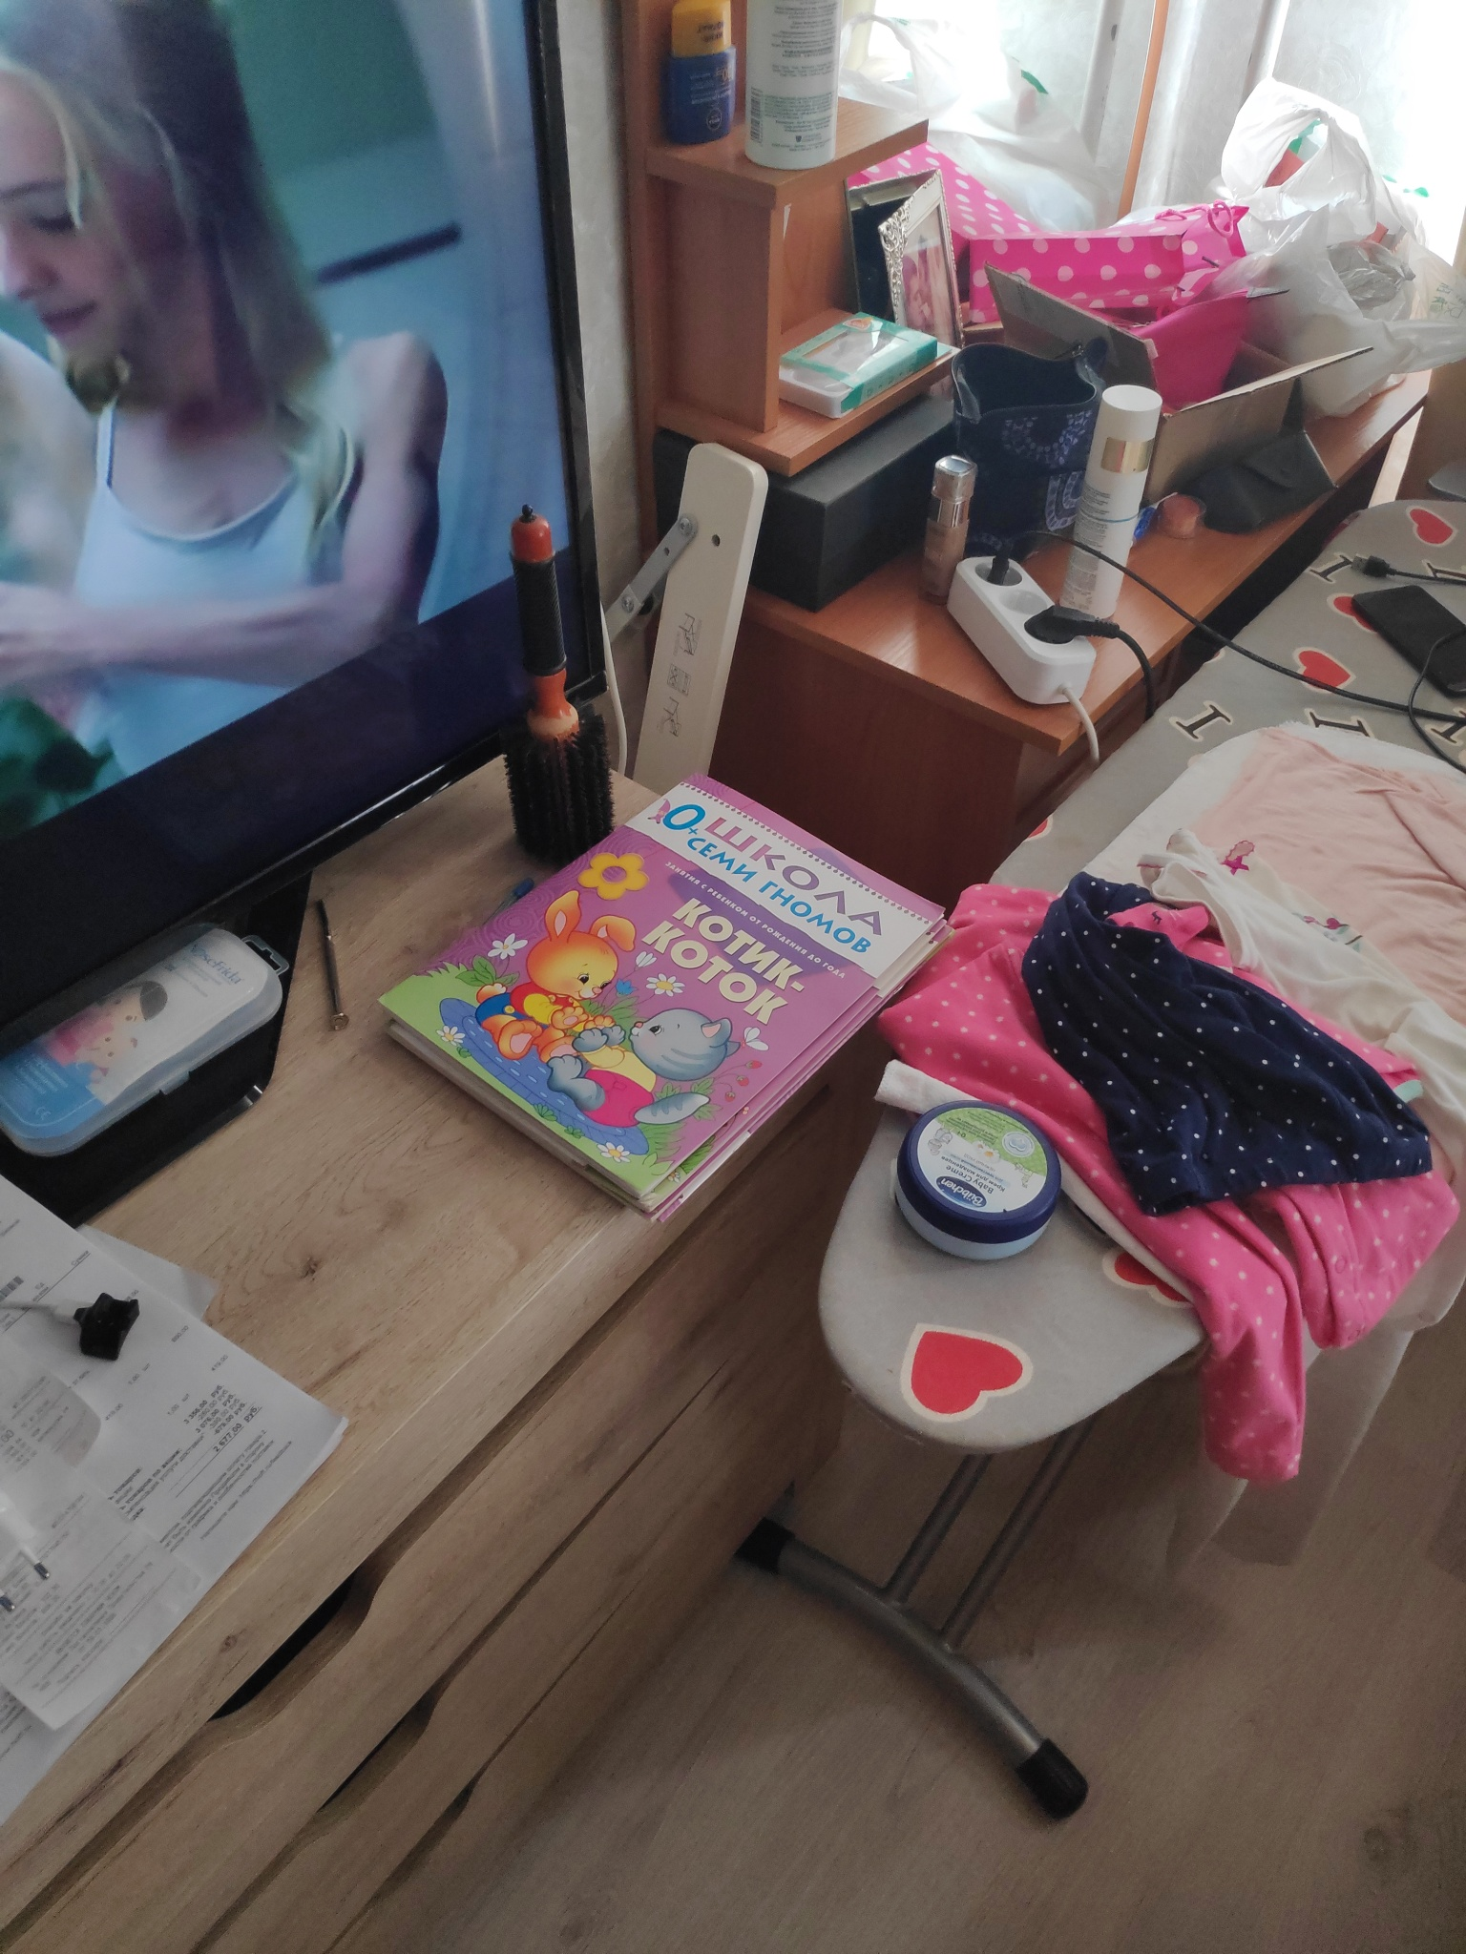
Data set
The image deblurring data set contain 350 images of 2 sets
The first set contain clear sharp images
The second set contains pixalated low resolution images.

Slide 15

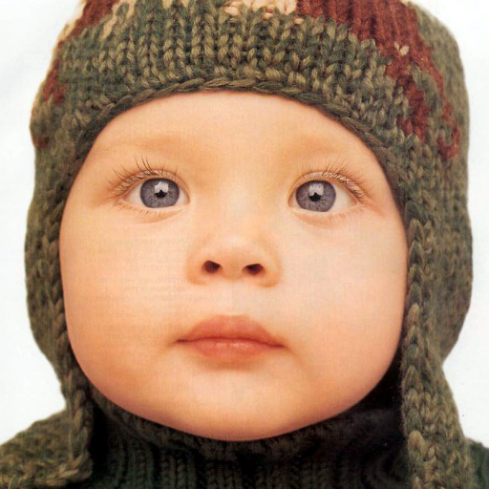
dataset
The SRGAN uses high resolution images for super resolution

Slide 16
Use cases
Consumer photography for image denoising and deblurring un focused images.
Suspect detection from uncleared camera visuals
Blurred images captured by satellites can be converted to higher resolution images.
Low resolution images of internal organs can be enhanced to higher resolution images for easier diagnosis in the medical field

Slide 17
references

Slide 18
Thank you

